Slide 1
MPEG-2 Tables Structure
& Digital Standards

Slide 2
Agenda
PSI table structure
DTV Standards
    DVI
    ATSC
    ISTB
Comparison of DTV standards

Slide 3
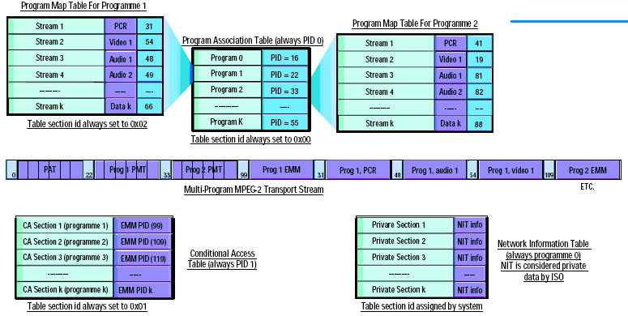
MPEG-2 PSI Tables Structure

Slide 4
MPEG-2 PSI Tables
To reconstruct the PES, the PSI uses a series of identifiers known as the Program Identifiers, or PID's
Once the program to be decoded is known, the decoder searches for PID=0 - the Program Association Table PID
The PAT contains the PID's of all the PMT's for the programs contained.
We assume program one has been chosen for decode
The PMT for program 1 is identified via its PID (22), extracted from the transport stream packets containing it, and decoded
Prog 1's PMT contains all the PID's for Prog1's video, audio and data packets. These must be put together to reconstruct the PES
Prog 1's timing info, required for decode, is contained in a transport packet, identified by the PCR PID (31). Each prog has a PCR
PID zero is always used to identify the CAT. This is needed to find out whether the consumer is allowed to decode and view prog 1
The CAT contains all the PID's identifying the EMM's for all progs
The NIT, contains information about the user-selected service. Such as channel freq.'s transponder numbers etc. The NIT is always associated with prog 0's PID

Slide 5
Digital video broadcasting (DVB) Standards
DVB Project was founded in Europe in 1993 as an industry led consortium of 290 broadcasters, manufacturers’ s/w developers & regulatory bodies in 35 countries to adopt a standard for digital broadcasting that would bring more programme choice to the home at an affordable price and with efficient use of the frequency spectrum.
The MPEG-2 video compression standard and transport mechanism is same for DVB.
Audio compression standards used MPEG1&2 or Dolby AC3 audio.
Service Information tables used: DVB SI
DVB-T
DVB-T -- Europe, UK, Taiwan, Russia, Australia, Africa, China & NZ etc..,
DVB-C
DVB-C -- Almost All counties.
DVB-S
DVB-S -- Almost All countries.
DVB-S uses QPSK , 8PSK or 16QAM digital Modulations. Bit rate 40 Mb/s

Slide 6
DVB-T Digital Modulation
Available bitrates (Mbit/s) for a DVB-T system in 8 MHz channels
Modulation | Coding rate | Guard interval
 |  | 1/4 | 1/8 | 1/16 | 1/32
QPSK | 1/2 | 4.976 | 5.529 | 5.855 | 6.032
 | 2/3 | 6.635 | 7.373 | 7.806 | 8.043
 | 3/4 | 7.465 | 8.294 | 8.782 | 9.048
 | 5/6 | 8.294 | 9.216 | 9.758 | 10.053
 | 7/8 | 8.709 | 9.676 | 10.246 | 10.556
16-QAM | 1/2 | 9.953 | 11.059 | 11.709 | 12.064
 | 2/3 | 13.271 | 14.745 | 15.612 | 16.086
 | 3/4 | 14.929 | 16.588 | 17.564 | 18.096
 | 5/6 | 16.588 | 18.431 | 19.516 | 20.107
 | 7/8 | 17.418 | 19.353 | 20.491 | 21.112
64-QAM | 1/2 | 14.929 | 16.588 | 17.564 | 18.096
 | 2/3 | 19.906 | 22.118 | 23.419 | 24.128
 | 3/4 | 22.394 | 24.882 | 26.346 | 27.144
 | 5/6 | 24.882 | 27.647 | 29.273 | 30.160
 | 7/8 | 26.126 | 29.029 | 30.737 | 31.668

Slide 7
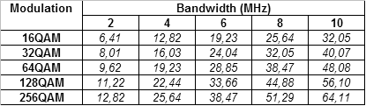
DVB-C Digital Modulation
Available bitrates for a DVB-C system, All (decimal) values in Mbit/s.

Slide 8
DVB SI Tables
DVB Service Information (SI) tables give service providers the tools necessary to offer programs and services across a large network of transport streams.
These tables are added to the MPEG-2 transport stream during encoding or multiplexing.
They work together with the MPEG-2 PSI tables to give the decoder access to all available programming across an entire network.
SI tables also provide information for the Electronic Program Guide (EPG), which shows viewers a description of all current and upcoming events, along with their start time and duration.
Like all other packets in the transport stream, those that contain SI tables are identified by PID number. The following table gives a basic overview of the SI tables.

Slide 9
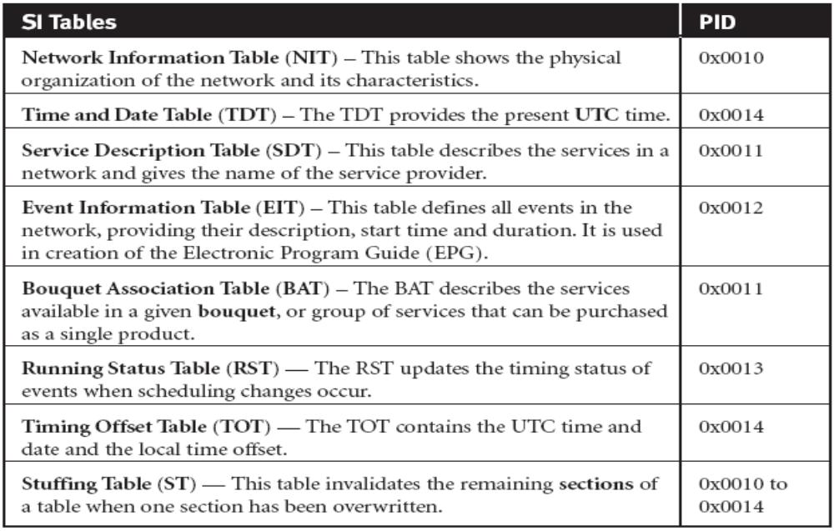
DVB SI Tables

Slide 10
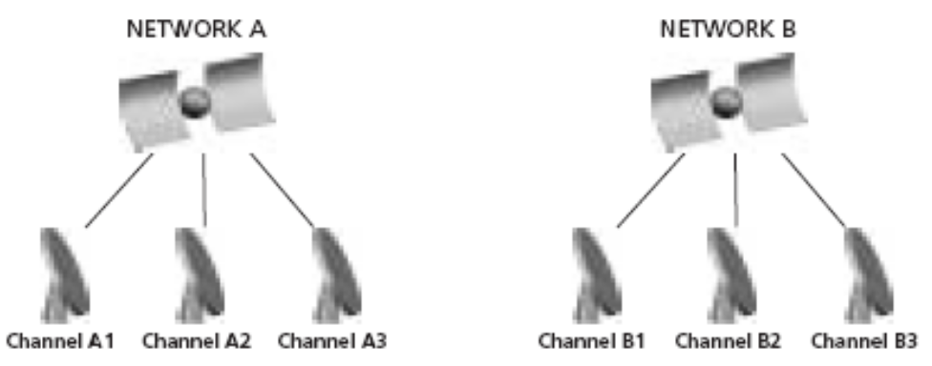
DVB SI Tables
Time and Date Table (TDT)
The Time and Date Table (TDT) provides the present UTC date and time, which can be adjusted according to time zone and presented on the screen for the viewer.
Network Information Table (NIT)
The Network Information Table (NIT) contains network characteristics and shows the physical organization of the transport streams carried on the network.
The decoder uses the tuning parameters provided in this table to change channels at the viewer’s request when the desired program is not on the current transport stream.
Tuning parameters are specific to the type of transmission assigned to the network, whether it be terrestrial, cable or satellite.

Slide 11
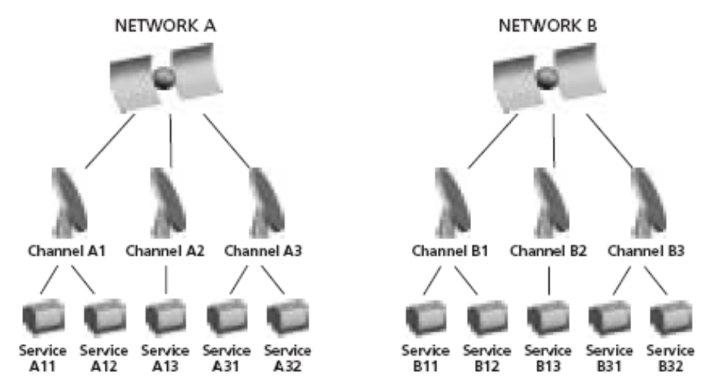
DVB SI Tables
Service Description Table (SDT)
The Service Description Table (SDT) defines the services available on the network and gives the name of the service provider.
A service is a sequence of events that can be broadcast as part of a schedule.
Two types of SDTs, “Actual” and “Other,” are required by DVB. The SDT Actual describes the services available on the transport stream currently being accessed by the viewer, while the SDT Other describes services available on all other transport streams in the network.

Slide 12
DVB SI Tables
Event Information Table (EIT)
The Event Information Table (EIT) defines all events in the network, including their description, start time and duration.
We often refer to events as “TV programs.”
Three different types of EITs can be transmitted simultaneously: the EIT Present, the EIT Following and the EIT Schedule.
    EIT Present describes the events currently being broadcast on the transport stream being accessed by the viewer.
    EIT Following provides information about the next events to be broadcast on the same transport stream.
    EIT Schedule lists all events available on the network for anywhere from the next few hours to the next few days, depending on the service provider’s implementation. It provides the main source of information for the Electronic Program Guide (EPG)

Slide 13
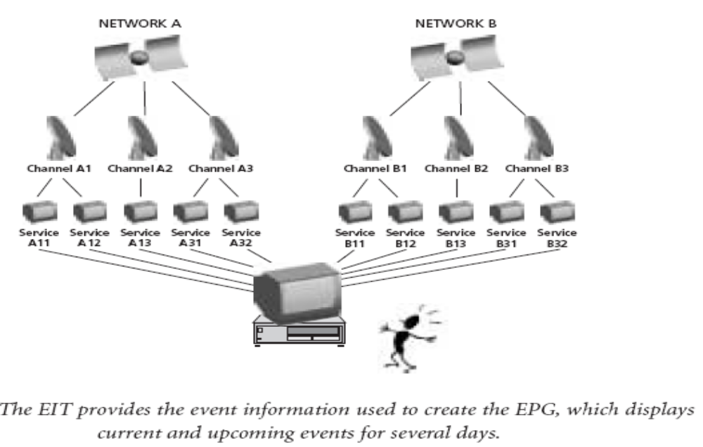
DVB SI Tables

Slide 14
Advanced Television Systems Committee (ATSC) Standards
The USA FCC adopted the major elements of the ATSC Digital Television Standard (A/53) in 1996 for the nation's next generation of broadcast television. Similar aims to DVB but with more emphasis on HDTV at the outset.
The MPEG-2 video compression standard and transport mechanism is same for ATSC.
Audio compression standards uses Dolby AC3 audio.
Service Information tables used PSIP (USA)
ATSC uses 8-VSB digital modulation, bitrate is 19.2 Mbits/ sec, Bandwidth 6MHz.
ATSC PSIP Tables
These are additional tables defined by ATSC for terrestrial and cable only

Slide 15
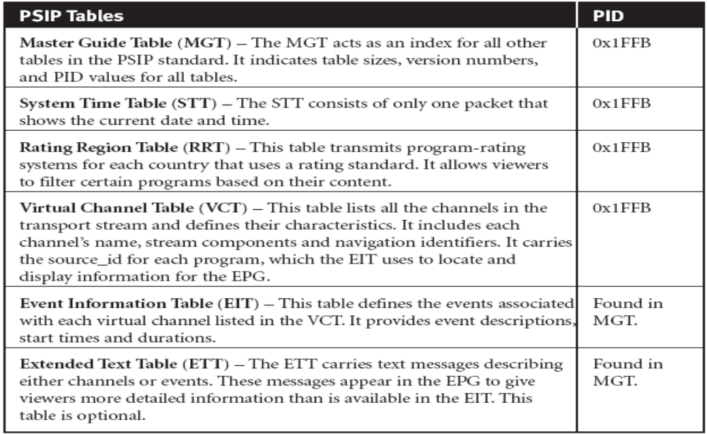
ATSC PSIP Tables

Slide 16
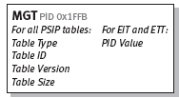
Master Guide Table (MGT)
The Master Guide Table (MGT) acts as an index for all other PSIP tables. It defines
  Table sizes, necessary for proper decoding;
  Version numbers, which help to identify the tables that need to be updated;
  PID values, which enable the decoder to locate the packets that contain the EITs and ETTs.

Slide 17
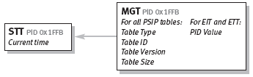
System Time Table (STT)
The System Time Table consists of only one packet, which serves as a reference for the current time of day.
This information enables the decoder to start advertised events on schedule.

Slide 18
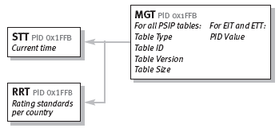
Rating Region Table (RRT)
The Rating Region Table (RRT) transmits program rating systems for each country that uses a rating standard.
The information in this table allows viewers to filter certain programs based on their content.
The decoder uses information in the MGT to locate and create the RRT.

Slide 19
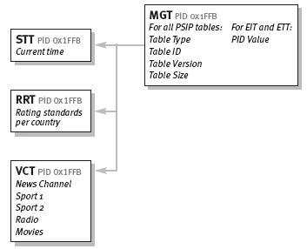
Virtual Channel Table (VCT)
The Virtual Channel Table (VCT) lists all the channels in the transport stream and defines their characteristics. This includes the channel name, the stream components, stream types, and navigation identifiers.
The VCT also carries the source_id for each program, which the EIT uses to locate and display channel information for the EPG.
The decoder uses information in the MGT to find and build the VCT.

Slide 20
Event Information Table (EIT)
The Event Information Table (EIT) defines the events associated with each of the virtual channels listed in the VCT.
It provides event descriptions, start times and durations. The decoder uses these to create the EPG.
According to the ATSC specification, between four and 128 EITs must be in the transport stream at any given time.
Each EIT provides event information for a three-hour time period, so up to sixteen days of programming can be advertised in advance in the EPG.
EIT-0 always contains information for the current three-hour time block, while EIT-1 defines programming for the next three hours.
The PID value for each EIT is defined in the MGT, and the VCT supplies the channel identifier, or Source ID, for each event in the EIT.

Slide 21
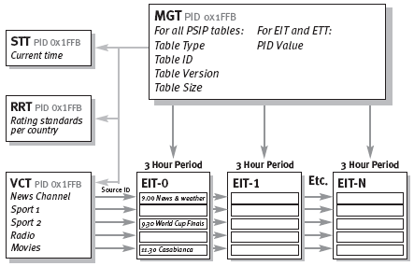
Event Information Table (EIT)

Slide 22
Extended Text Table (ETT)
Extended Text Tables (ETTs) carry text messages describing both channels and events; hence, there are two types of ETTs: Channel ETTs and Event ETTs.
ETT messages are displayed in the EPG to give viewers more detailed information than is available in the EIT.
For example, Channel ETTs may contain information about the price of a channel or its coming attractions.
Event ETTs might include a short paragraph describing a specific event, such as a movie. ETTs are optional, and the PID number for each ETT is defined in the MGT.

Slide 23
Integrated Services Digital Broadcast (ISDB) Standards
The Japanese Ministry of Posts and Telecommunications followed suit and launched the BS-Digital standard for satellite transmission as first step towards the Integrated Services Digital Broadcast (ISDB) network.
The MPEG-2 video compression standard and transport mechanism is same for ISDB.
Audio compression standards used MPEG AAC advanced audio coding (like MPEG4)
ARIB SI is additional tables defined by ARIB in Japan for satellite.
ISDB-S uses PSK modulation. Bandwidth 12 GHz
ISDB-T uses COFDM with PSK/QAM. Bandwidth 2.6 GHz
Note: ARIB stands for Association of Radio Industry and Businesses

Slide 24
Comparison of DTV Standards
 | ATSC | DVB | ISTB
Country | America | Europe | Japan
Video encoding | MPEG-2 | MPEG-2 | MPEG-2
Audio encoding | Dolby AC3 | MPEG-1,2, Dolby AC3 | MPEG AAC advanced
Modulation | 8 VSB digital modulation | QPSK, 8 PSK | ISTB-S: PSK ISTB-T: COFDM with PSK/QAM
SI Table | PSIP (USA) | DVB SI | ARIB SI

Slide 25
Thank you

Slide 26


